Slide 1
Visualize OD data with Flowmap.blue
Praktikum XII - Visualisasi Data & Informasi

Slide 2
Flowmap.blue
Flowmap.blue is an open-source tool that helps visualize the movements between 2 geographic locations.

Slide 3
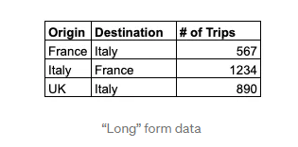
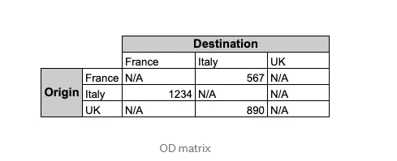
Origin-Destination (OD) data
OD data, or “flow data,” serves the function of representing geographic movement. It comes either in “long” form or as a matrix. In the first case, each row will have the OD pair (origin and destination) and the number of trips between the origin and destination.

Slide 4
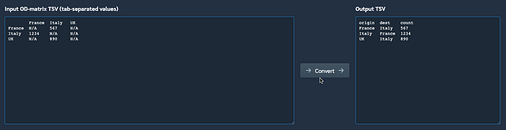
Flowmap.blue has a matrix converter that allows you to convert a matrix into a long form and copy/paste the tabular output in a spreadsheet.
In Flowmap.blue, you’ll need to use long form data.

Slide 5
Why should I care about OD analysis?
helpful for a myriad of reasons:
urban planning,
transportation networks design,
real estate investments,
supply-chain logistics,
human migration policies, etc
Mobility data is important to understand what inefficiencies exist in the modern geographic spaces to help develop a better response
OD analysis helps identify today’s geographic gaps for better resource allocation tomorrow.

Slide 6
Data
San Francisco Bay Area’s BART ridership data for 2021
https://www.bart.gov/about/reports/ridership
Template
https://docs.google.com/spreadsheets/u/1/d/1aEgwtGUGc0TdnsO0jIm50hshCZ-m4DHms3P0Qq9IYdA/edit#gid=1438429083
https://flowmap.blue/

Slide 7
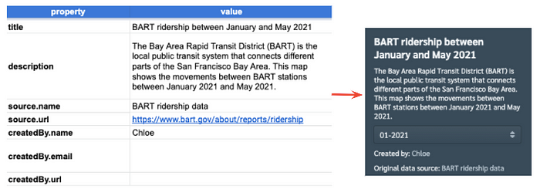
“properties”, “locations”, & “flows”
Properties (metadata of the visual created)
chart title, a description, the data source and your own info.

Slide 8
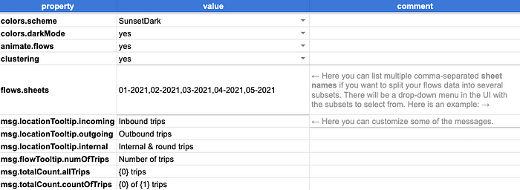
format the map by selecting the colors, animation/cluster feature, and word choices for the toolbox

Slide 9
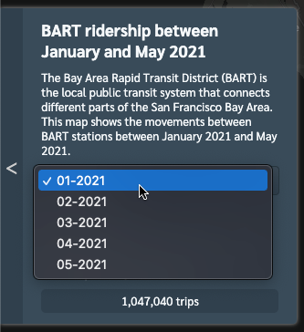
the flows.sheets “value” cell contains comma-separated values. Those will inform the month/year drop-down you see below. For each drop-down value, you’ll need to create a separate tab on the template.

Slide 10
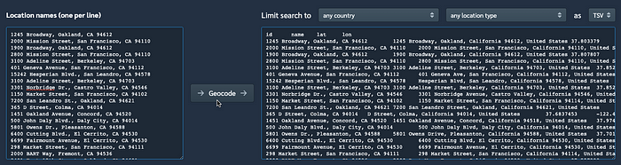
Locations
Populate locations, including the GPS coordinates. If you only have the location names without the GPS coordinates, you can use Flowmap.blue’s geocoding tool.
Copy/paste the result on the “locations” tab of the spreadsheet.

Slide 11
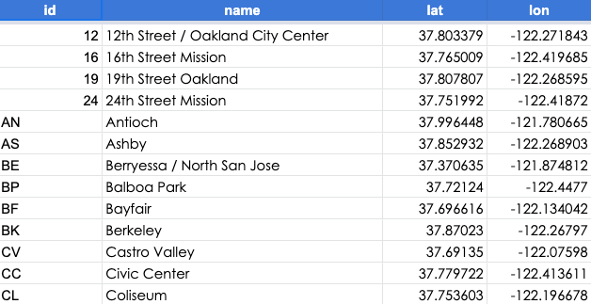
enter the data: id, name, latitude, and longitude.

Slide 12
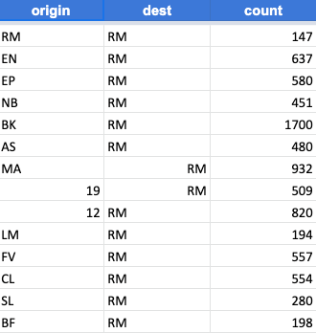
Flows
the number of trips taken between the origin and the destination. If you’re not interested in creating a filter, you can simply fill out the “flows” tab. However, if you want to create a drown-down, you’ll need to create a new tab for each value you want added to the drop-down
On each tab, enter the origin, destination, and the aggregated number of trips.

Slide 13
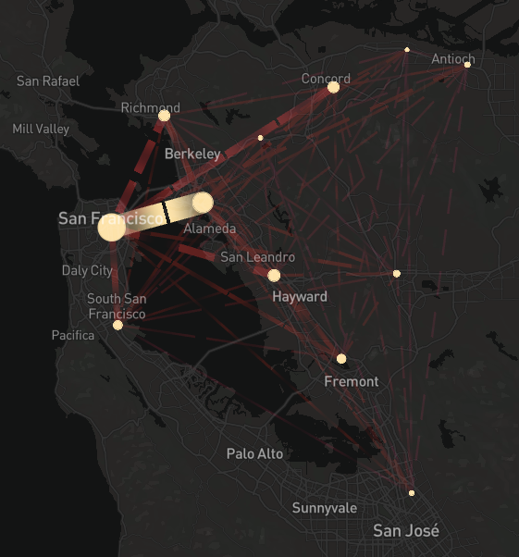
Share the template “Anyone with the link.”
Copy/paste the link in the dedicated box on Flowmap.blue. Click “Open” to view the final result in Flowmap.blue.
You can zoom in or out, filter on the month by using the drop-down menu, or toggle the settings (bottom left corner). While Flowmap.blue is a convenient, low-code and user-friendly tool

